Slide 1

Eco Friendly Strategies in Urban Planning - Enviro
Teammates
Priyadharsini.K (41120144)
Rethisha.R (41120151)

Slide 2
Objectives
The project aims to provide a user-friendly platform where users can easily schedule waste pickups and manage their profiles. By converting household organic waste into fertilizers and manures.
The project promotes sustainable practices. It also focuses on the safe disposal of industrial waste to minimize environmental impact.

Slide 3
Abstract of the Project
The Enviro project is an innovative waste management initiative focused on collecting waste from households, industries, and common areas to ensure environmentally responsible disposal and recycling.
This project aims to transform household and Food waste into valuable fertilizers and manures through advanced composting techniques, promoting sustainable agriculture and reducing landfill dependency. Concurrently, industrial waste is meticulously segregated and processed to neutralize any hazardous components, ensuring safe disposal without environmental harm.
By integrating modern technology and community participation, Enviro seeks to establish a comprehensive waste management system that minimizes ecological footprints, enhances resource recovery, and fosters a cleaner, healthier environment for future generations.

Slide 4
Existing System
The existing waste management system involves regular curbside collection of household and industrial waste, limited source segregation, and transportation to processing facilities.
Organic waste is composted into fertilizers, recyclables are processed at recycling centers, and hazardous industrial waste is treated for safe disposal. Residual waste is typically sent to landfills or incineration plants, both posing environmental challenges.
Public awareness campaigns and incentive programs exist to encourage waste reduction and recycling, but participation and effectiveness vary. This system, while functional, faces issues with efficiency and environmental impact.

Slide 5
Proposed System
The proposed Enviro system enhances waste management by implementing regular, eco-friendly waste collection and advanced segregation at the source.
Household organic waste ( Fruits, vegetables , food ,,,etc) will be converted into high-quality fertilizers and manures through efficient composting techniques, while industrial waste will be carefully segregated and neutralized to ensure safe disposal.
Smart technology will optimize collection routes and processing methods, and community involvement will be bolstered through educational programs and incentives. This comprehensive approach aims to reduce landfill dependency, improve soil quality, and minimize environmental pollution.

Slide 6
Software Requirements
Frontend Technologies
HTML
CSS
JavaScript
Backend Technologies
Node.js
Express.js
Database Management
MySQL
Development Environment
Visual Studio Code

Slide 7
Hardware Requirements
A robust server with a multi-core processor, ample RAM (e.g., 16GB or more)
SSD storage for hosting the web application and backend operations.
Separate hardware for MySQL database hosting, featuring a multi-core processor, sufficient RAM (e.g., 8GB or more), and SSD storage to ensure efficient data management and retrieval.

Slide 8
Modules
User Authentication Module
Service Provider Module
Waste Collection Module
Backend integration

Slide 9
User Authentication
It facilitates user interaction by allowing residents and businesses to request waste collection services. It includes a detailed form where users can input their personal details such as name, email, contact number, address, and preferred pickup times.
This module is integrated with the backend system to securely store the submitted data and manage collection schedules efficiently. The form is designed to be user-friendly, ensuring that users can easily fill in their information and request services.
The Login offers secure access to personalized services for returning users. It features a login form with fields for username and password, along with a "Forgot Password" link that guides users through the process of recovering their credentials.

Slide 10
Service Provider Module
The Services Provided Module outlines the various waste management services offered by Enviro, categorized into household waste collection, organic waste management, e-waste disposal, and industrial waste management. For household waste,
It describes the systematic collection and sorting processes that ensure efficient waste handling. The organic waste management section details the composting techniques used to convert organic waste into high-quality fertilizers, promoting eco-friendly agricultural practices.

Slide 11
Waste Collection Modules
It is Responsible for managing the scheduling and execution of waste pickups for household, organic, and e-waste. Users can fill out a form specifying their waste type, preferred pickup times, and address details.
This modules processes these requests and organizes efficient collection routes to ensure timely and effective waste management.

Slide 12
Backend Integration
The Backend Authentication module in Project Enviro is crucial for ensuring secure access to the system. It handles user login, registration, and authentication processes, verifying credentials using secure hashing algorithms to protect passwords.
This module manages user sessions, enforces role-based access control, and safeguards sensitive information. By providing robust authentication mechanisms, the Backend Authentication module ensures that only authorized users can access and interact with the system, maintaining the integrity and security of user data.

Slide 13
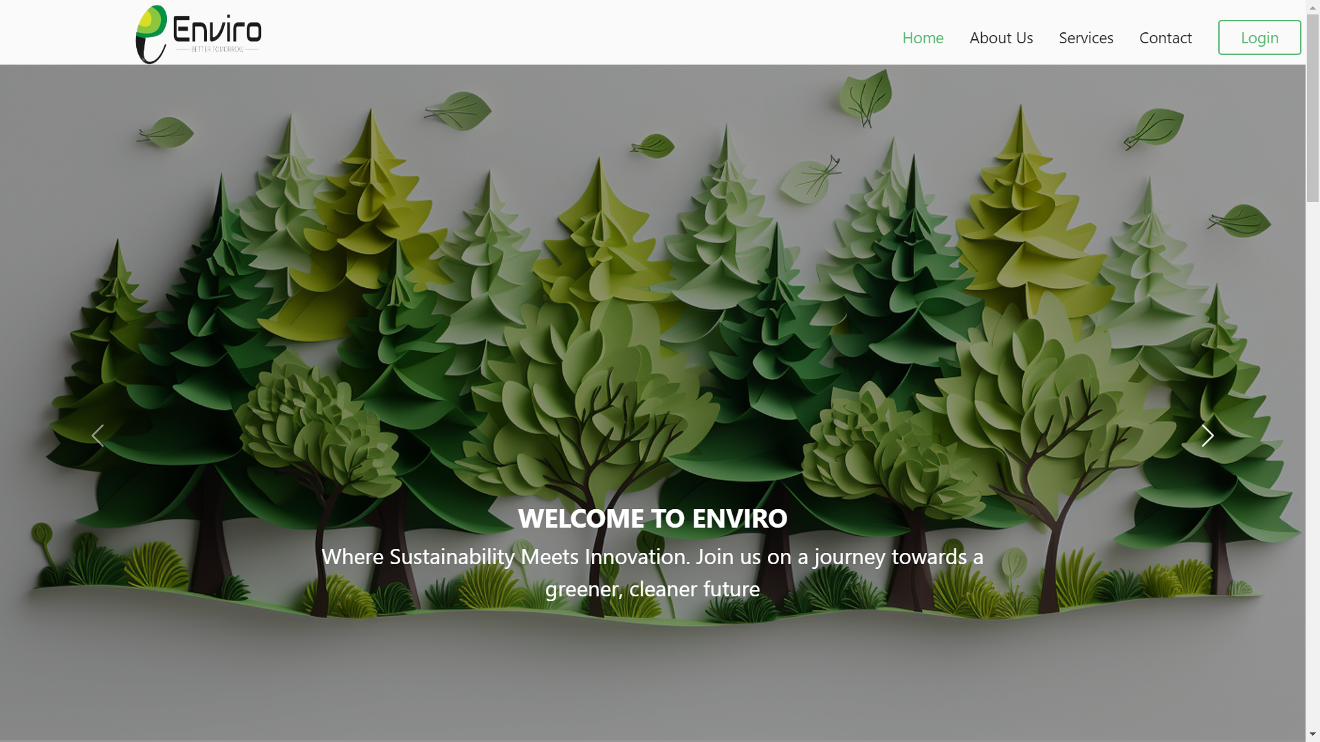
Output ( Home page )

Slide 14
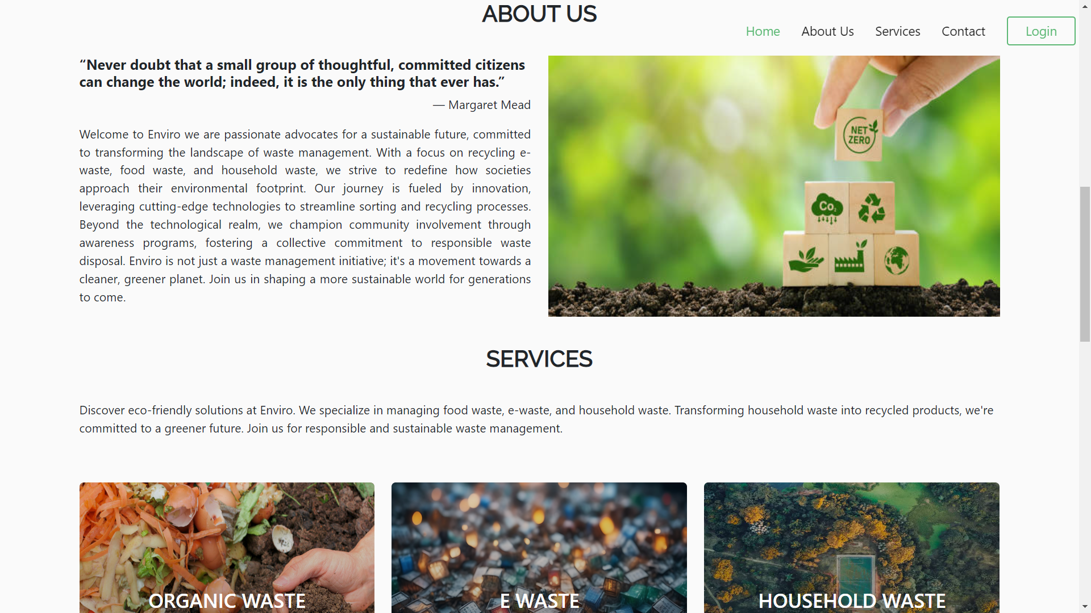
About us and Service page

Slide 15
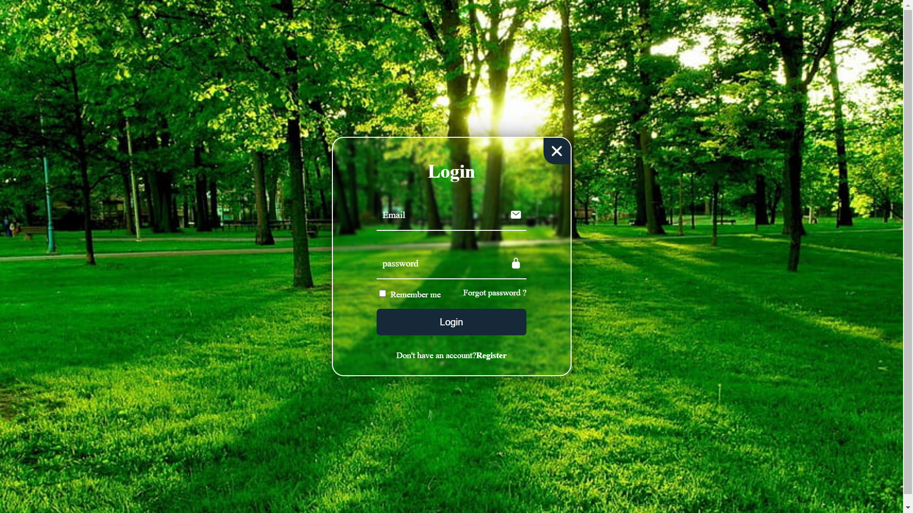
User login and Registeration page

Slide 16
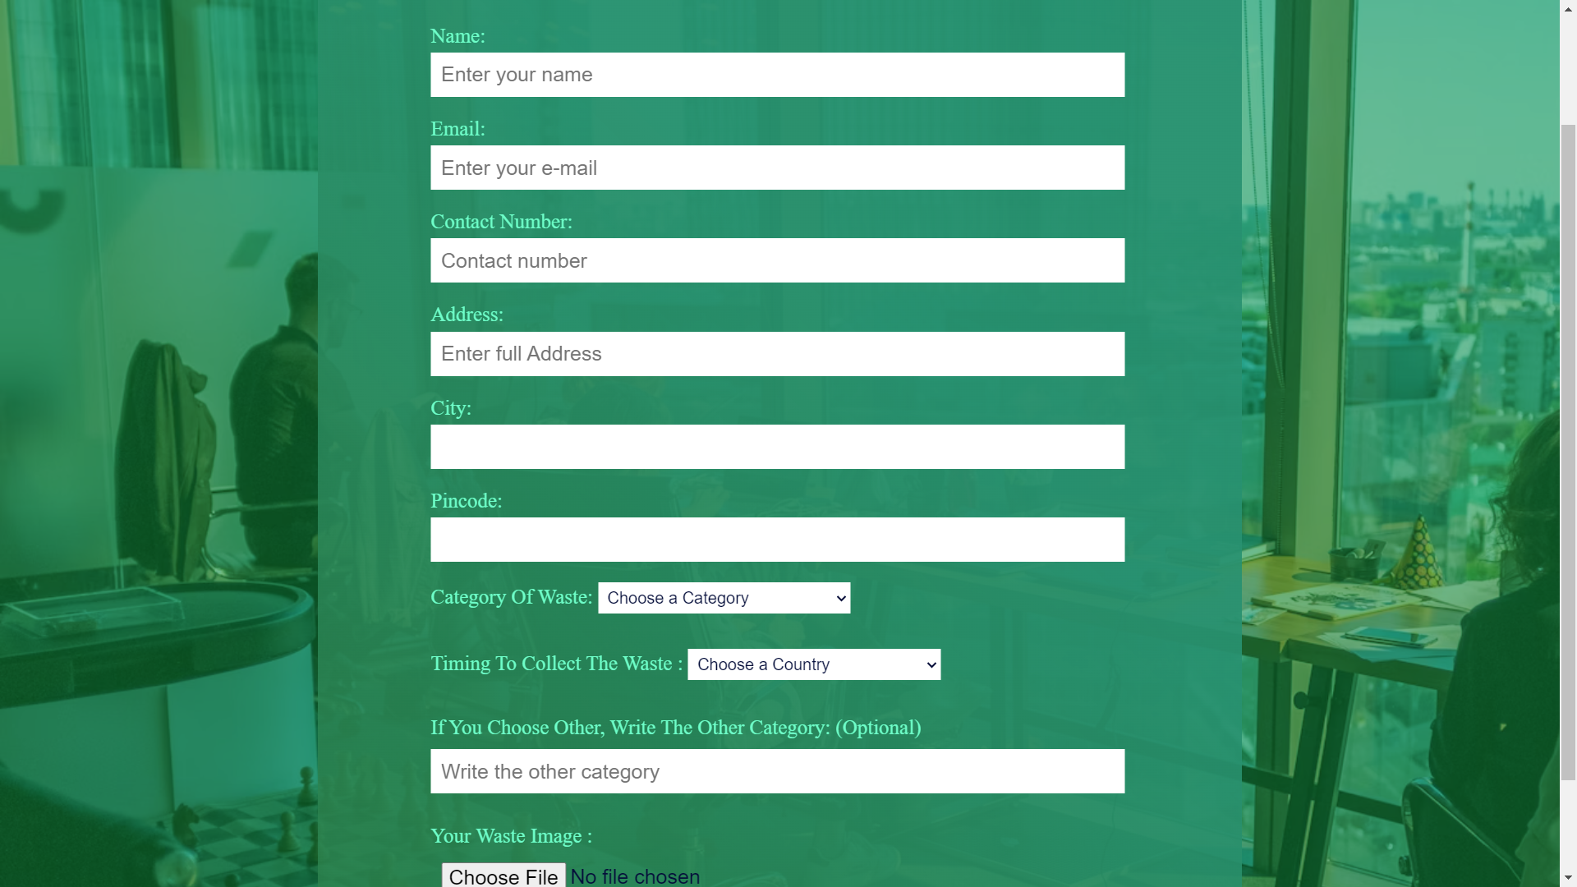
Waste Collection Form page

Slide 17
Conclusion
Project Enviro represents a significant step forward in modern waste management, leveraging technology to streamline collection processes, promote sustainable practices, and engage communities effectively. By integrating user-friendly interfaces for waste scheduling and management, robust backend systems for secure data handling, and adherence to environmental standards in waste disposal, the project aims to enhance efficiency while minimizing environmental impact. Through continuous improvement and community involvement, Project Enviro strives to set a precedent for innovative and responsible waste management solutions that benefit both urban environments and industrial sectors alike.

Slide 18
Thank You

